Slide 1


ProperT
Blockchain Hackathon Team 4
A P2P tokenized smart property management system

Slide 2
Agenda
Problem Statement
Introduction to Team
Answers to the Questionnaire (Data)
Existing System
Proposed Solution
Platform Specifications
Business Applications, Post course
Demo
Q & A

Slide 3
Problem Statement
Land & Property Ownership - In India land ownership is primarily established through a registered sale deed (a record of the property transaction between the buyer and seller). Other documents used to establish ownership include the record of rights (document with details of the property), property tax receipts, and survey documents. However, these documents are not a government guaranteed title to the property, but only a record of the transfer of property. During such transactions, the onus of checking past ownership records of a property is on the buyer. Therefore, property ownership in India, as determined by such sale deeds, is presumptive in nature, and subject to challenge This use case has a big potential for Blockchain integration.

Slide 4
Team
Srinivas Kotikila
Rajatha
Shashi P
Syeda Fathima
Pavana J
Shailesh
Saida Vali

Slide 5
Answers to the Questionnaire (Data)
We chose this application because a) Domain expertise b) Interest in the area - Team is interested in future property market c) Growth potential - The overall growth potential & the size of the market is extremely attractive for this team.

Slide 6
Existing System
Stamp duty - 3-7%
Contract creation
Sub registrar of Assurance office – document submission (photo, property card, etc)
Verbal agreement
Preparation of contract
– sale document
Seller
Buyer
Municipal authorities- revenue and land records
Buyer of property in litigation
Reuters (2016) : The total cost of Property litigation right now in India is estimated as $10 Billion or 0.5% of the $2T Economy
https://www.ideasforindia.in/topics/macroeconomics/land-records-and-titles-in-india.html

Slide 7
Issues
A registered sale deed is not a government guarantee of land ownership.
This implies that
Land titles in India are unclear due to various reasons such as legacy issues from the zamindari system, gaps in the legal framework, and poor administration of land records.
Agricultural land cannot be used for commercial or residential purpose
Lack of coordinates to determine the accurate province of the land owned leads to conflicts

Slide 8
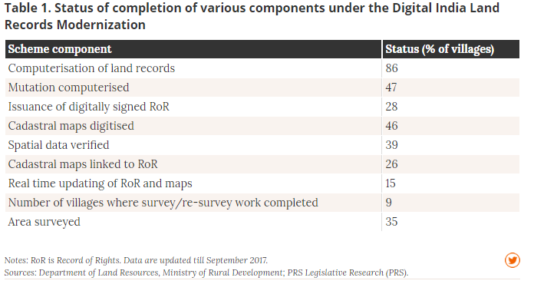
Statistics

Slide 9
Proposed Solution
All the digitized land records by the govt. are updated with coordinates (long & lat) to establish accuracy of the property record
Whenever, a transfer of ownership request is placed, the credibility of seller and buyer is verified using the Unique Identification authority
Once established, the platform will initiate the transfer on approval of the seller to transfer the ownership to buyer
This action will trigger an alert to all the custodians to provide concurrence by updating their respective database
Once completed, it the legal documents are shared with the buyer
Major Life Event Triggers
Unique Identification Authority
Banks and institutions
Registration office
Local bodies for permission
Regional Development authorities

Slide 10
The Model for the Future
Evolution of Blockchain backed Property Ownership
Peer to Peer Token Exchange
Smart Property Layer
State management of property on the Blockchain
UI for User Interaction & Query
KYC
Tokenization of Property
Apartment (Multi-storey + Multiple Owners)
Land + Structure (Multiple Owners)
Land + Structure (Single Owner)
Land (Multiple Owners + Mutation)
Land (Single Owner)
Government & Regulatory Ownership, Oversight
KYC Provider
(Aadhar)
Major Life Event Triggers
Registrar Office
Documentation, Legal & Compliance
Regional Govt Authorities
Bank & Financial Institutions

Slide 11


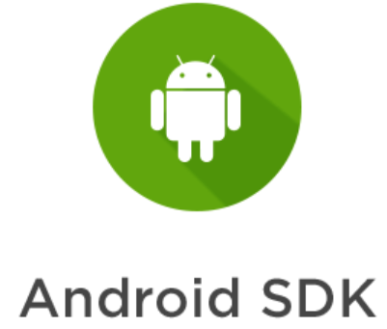

Platform Specification

Slide 12
Post Course
Plans to implement or take this forward after the course
Implement other layers in the evolution
Move into asset tokenization enabling partial ownership
Implement a Peer to Peer exchange for these asset tokens

Slide 13
Demo- Execution of the application

Slide 14


Slide 15


